Slide 1
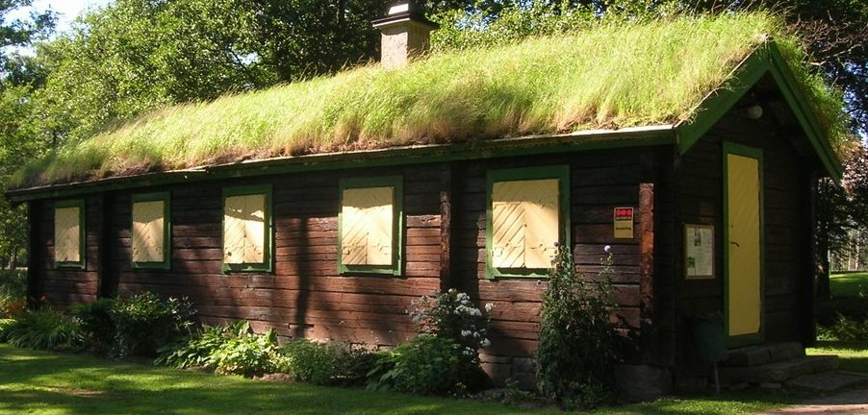
Green Roofs
Used for 1000s of years
Cool buildings in Africa
Retain heat for Vikings
www.2championroofing.com

Slide 2
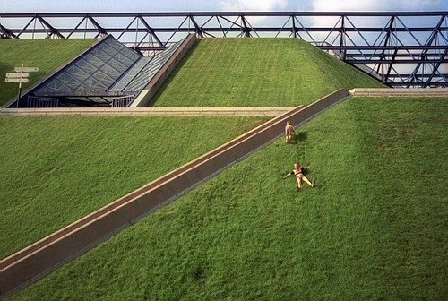
Types
Intensive
Like a garden
Extensive
Slow Growing, Stress-tolerant plants
Semi-Intensive
In-between
cdnimg.visualizeus.com

Slide 3
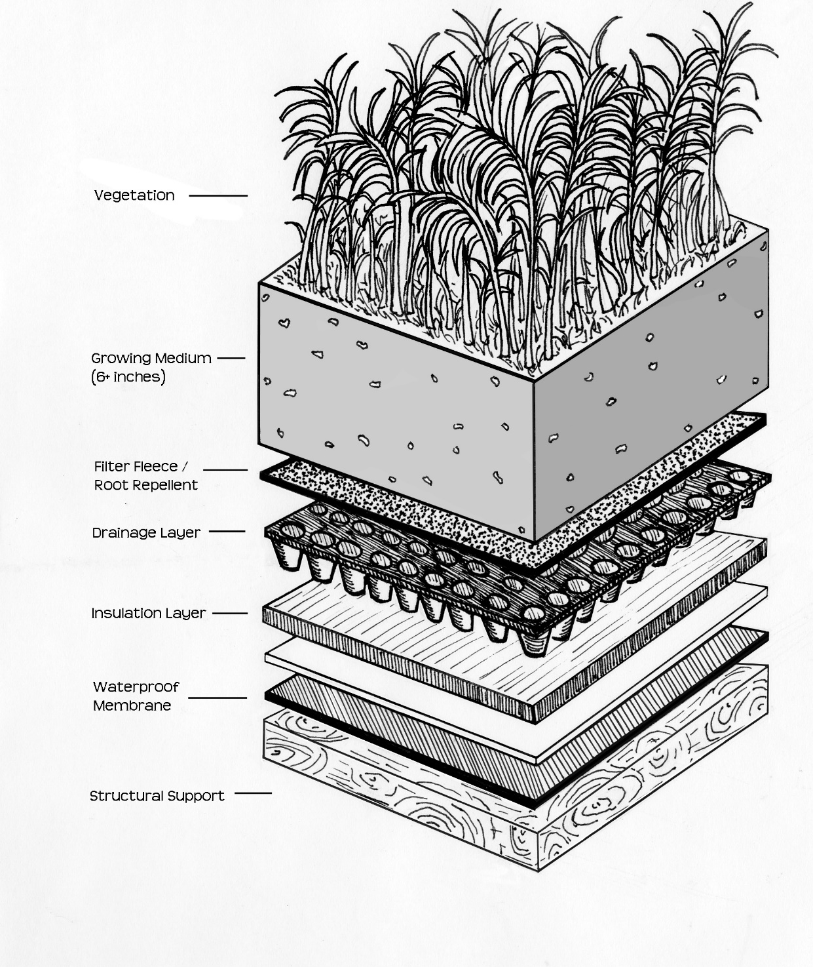
Intensive (6”+)
150+ mm layer substrate
Plants, vegetables, shrubs, trees,…
Frequent maintenance needed
Heavy
Provide a “park” where land is too expensive
www.greenroofplan.com
Green Roof Centre (2007) The Green Roof Pocket Guide, 2nd Ed.
Notes:
150+ from http://www.3riverswetweather.org/
Intensive: Intensive green roofs have greater than six inches of substrate. Intensive green roofs are particularly attractive for developers, property owners, and municipalities, in areas where land prices command a premium, but property owners want to provide some of the amenities associated with parks.

Slide 4
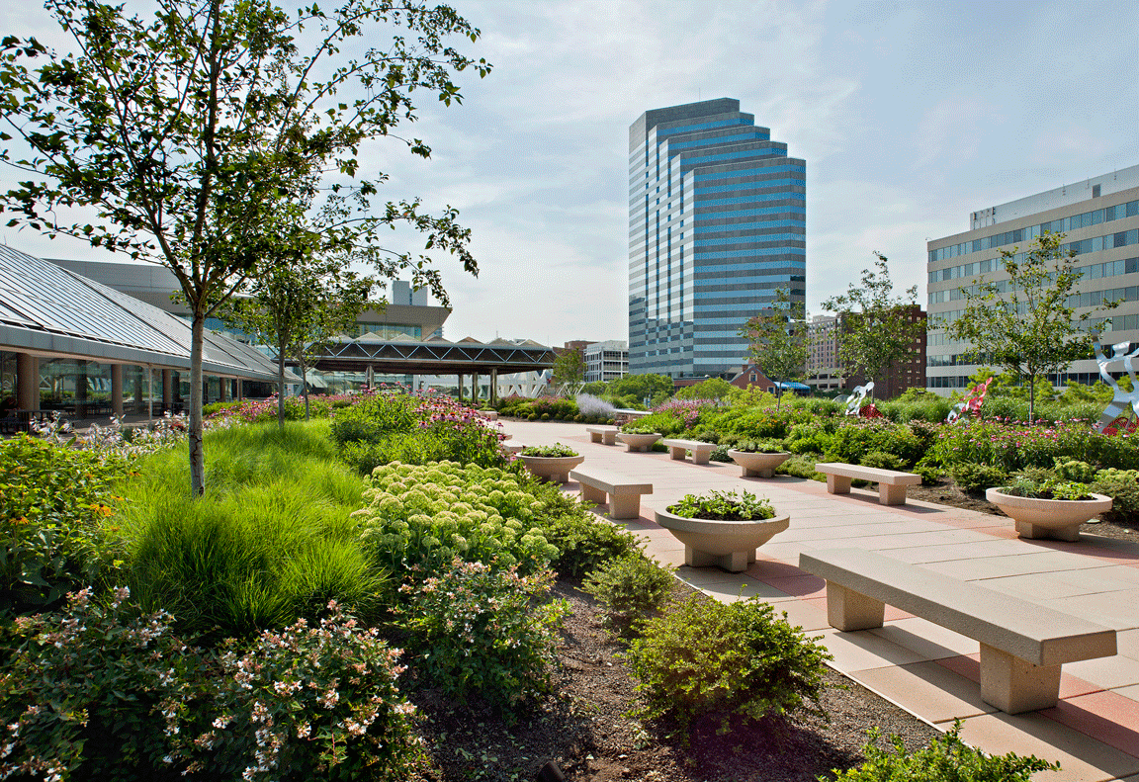
Intensive
Baltimore Convention Center
www.greenroofs.com
Notes:
Project Name: Baltimore Convention Center Year: 2010 Owner: City of Baltimore Location: Baltimore, MD, USA Building Type: Commercial Type: Extensive & Intensive System: Single Source Provider Size: 28000 sq.ft. Slope: 1% Access: Accessible, Open to Public Submitted by: Barrett Company & National Roofing Co. Designers/Manufacturers of Record: Architect: Chris Labosky, LEED AP, Gant Brunnett Architecture General Contractors: Chuck Sadowski, Project Manager, National Roofing Co., Inc. Waterproofing and Greenroof System Supplier: Barrett Company Greenroof System: Greenroof-Roofscapes? Technical Consultant: Barrett Company

Slide 5
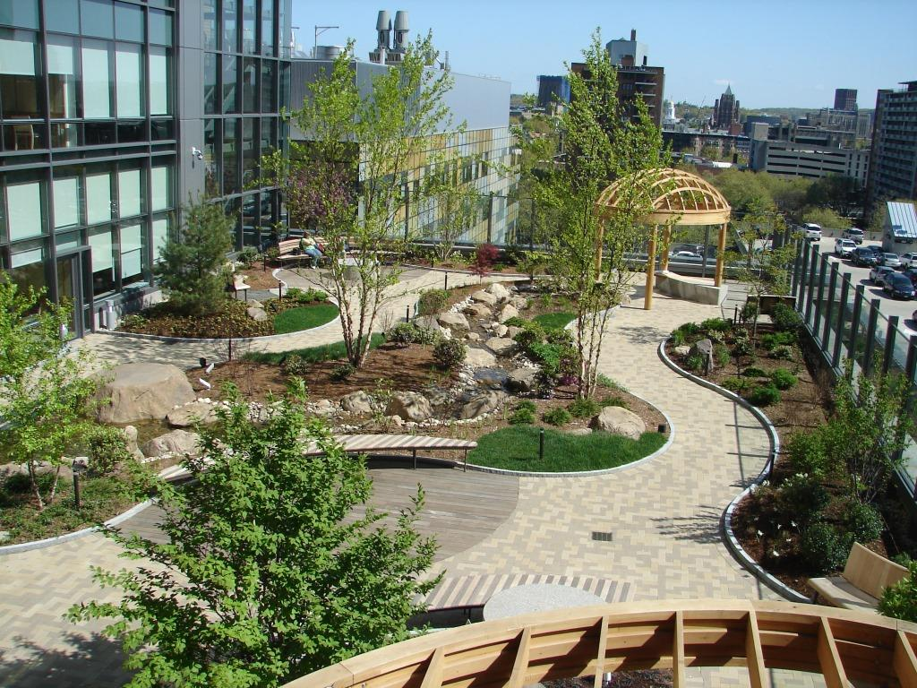
Intensive
Yale University
Smilow Cancer Hospital
www.greenroofs.com
Notes:
Yale University Smilow Cancer Hospital, New Haven, Connecticut, USA! The following is an intensive green roof project we constructed last in 2009. This project is located on the seventh floor of the Yale University Smilow Cancer Hospital. It contains a 90 foot water feature as well as 3,200 sq. ft. of clay pavers. The architectural firm who designed this project was Towers Golde, Inc. Photo by Albert Leavitt

Slide 6
Extensive (≤4”)
Sedum Roof
20-100 mm substrate
cuttings or plugs, or pre-grown mats
Meadow Roof
70-100 mm substrate
Dry habitat wildflower & grass seed mixes
Brown or Biodiversity Roofs
Allow a natural habitat to develop
Use crushed brick, leftover soils for substrate
Green Roof Centre (2007) The Green Roof Pocket Guide, 2nd Ed.
Notes:
http://www.3riverswetweather.org/
Extensive: Extensive green roofs have four inches or less of growing medium.Extensive green roofs provide many of the environmental benefits of intensive green roofs, but they are designed to be very low-maintenance and are not typically designed for public access.

Slide 7
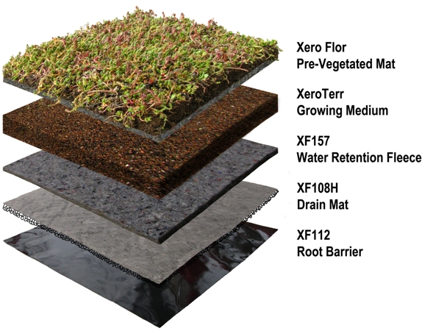
Pre-Vegetated Mats
www.xeroflora.com

Slide 8
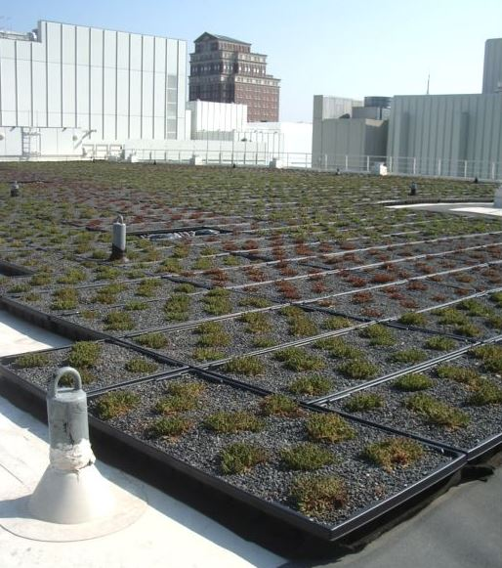
Modular Trays High Museum of Art Atlanta, GA, USA 2008
www.greenroofs.com
Notes:
Project Name: Frances Bunzl Administration Center of the High Museum of Art Year: 2008 Owner: High Museum of Art Location: Atlanta, GA, USA Building Type: Museum Type: Extensive System: Single Source Provider Size: 6680 sq.ft. Slope: 1% Access: Accessible, Private Submitted by: WESTON? Designers/Manufacturers of Record: Installation: WESTON? Planting Design Contributor: Savannah College of Art and Design Modular Greenroof System: GreenGrid? Plant Supplier: Saul Nurseries Growing Medium Supplier: ItSaul Natural

Slide 9
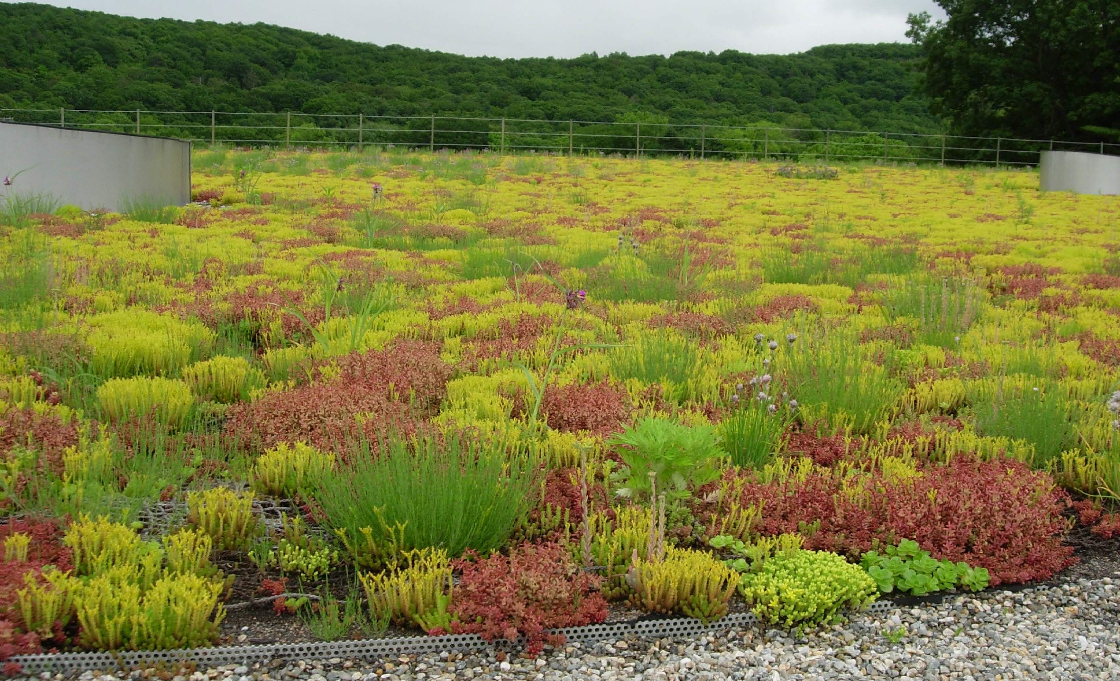
Sedum
www.asla.org
Water Treatment Facility, New Haven, CT
30,000 ft2 green roof was largest in Connecticut in 2010
Notes:
Wikipedia
Sedum is a large genus of flowering plants in the family Crassulaceae, members of which are commonly known as stonecrops. The genus has been described as containing up to 600 species ^{[2]} of leaf succulents that are found throughout theNorthern Hemisphere, varying from annual and creeping herbs to shrubs. The plants have water-storing leaves. The flowers usually have five petals, seldom four or six. There are typically twice as many stamens as petals.

Slide 10
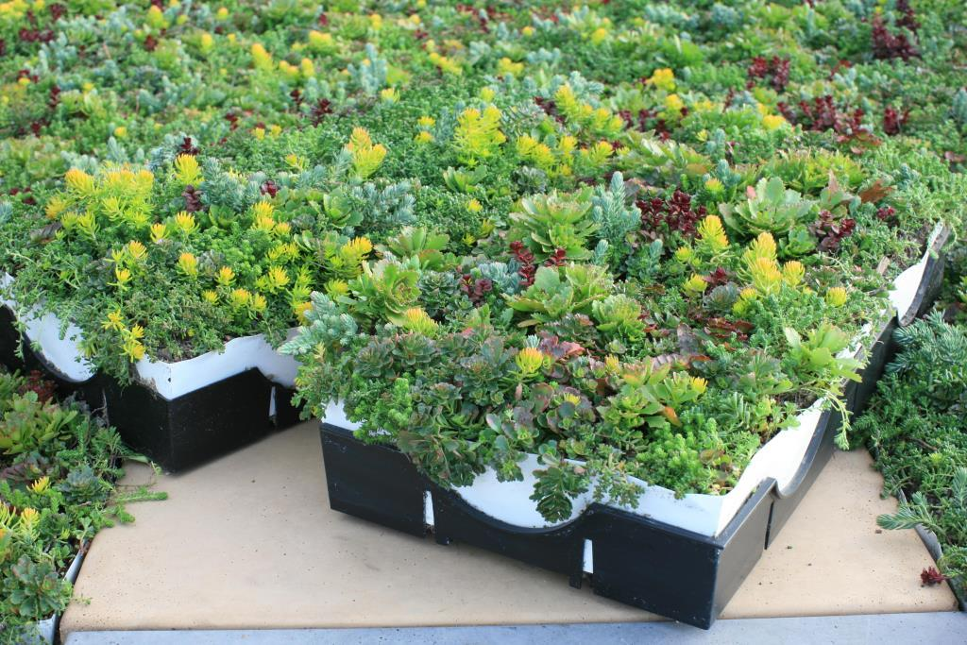
Modular Trays - Sedum
ww1.prweb.com

Slide 11
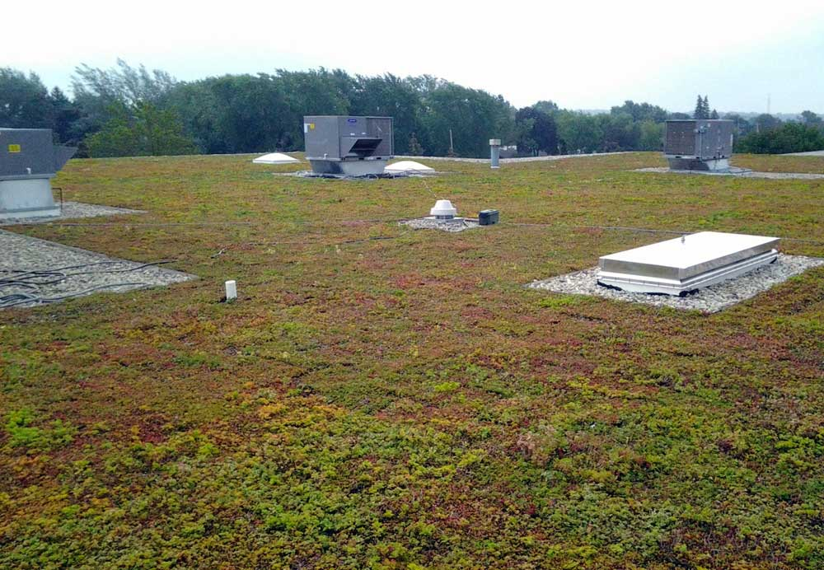
Sedum
www.americanrivers.org
J.W. Winco (New Berlin, WI) 15,800 ft2 green roof
Captures >18,000 gallons during 1-inch rainfall event
Reduces heating and cooling, improves air quality, extends roof life
Notes:
2013 article
J.W. Winco is one of many businesses stepping up to make a difference in their local watershed. They are major supplier of standard industrial machine components in New Berlin, Wisconsin, and recently completed installation of a green roof system on its manufacturing facility.
MMSD funding covered 29% of the cost of the project. This 15,800 square foot green roof is now one of the largest in the state, and is capturing over 18,000 gallons of stormwater during a 1-inch event. The sedum used on the roof was grown locally by Hanging Gardens.
The green roof will now greatly reduce heating and cooling costs, lower energy usage, improve air quality, increase urban green space, extend the roof life and reduce J.W. Winco’s stormwater fee paid to the city. J.W. Winco is also working with American Rivers on retrofitting their 2 acre parking lot with a combination of bioswales and porous pavement in the coming year.
- See more at: http://www.americanrivers.org/blog/business-case-sustainability/#sthash.RPtmy2Lw.dpuf

Slide 12
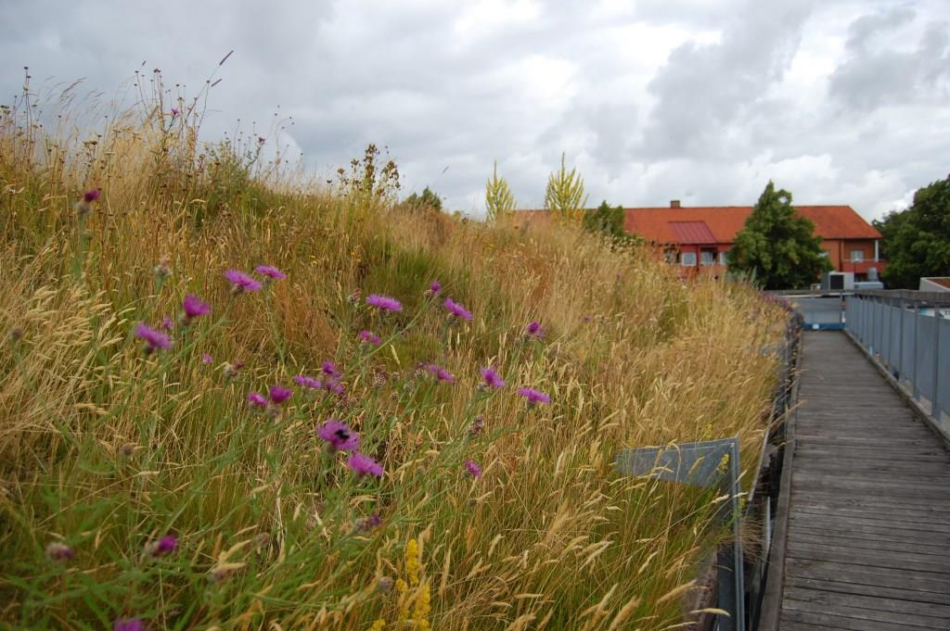
Meadow
greenroofmalmo.files.wordpress.com
Augustenborg Botanical Roof Garden, Malmo, Sweden

Slide 13
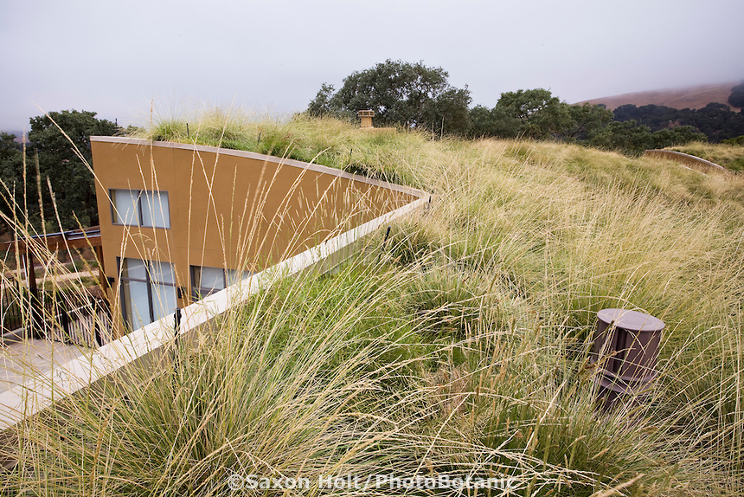
Meadow
cdn.c.photoshelter.com
Home, California

Slide 14
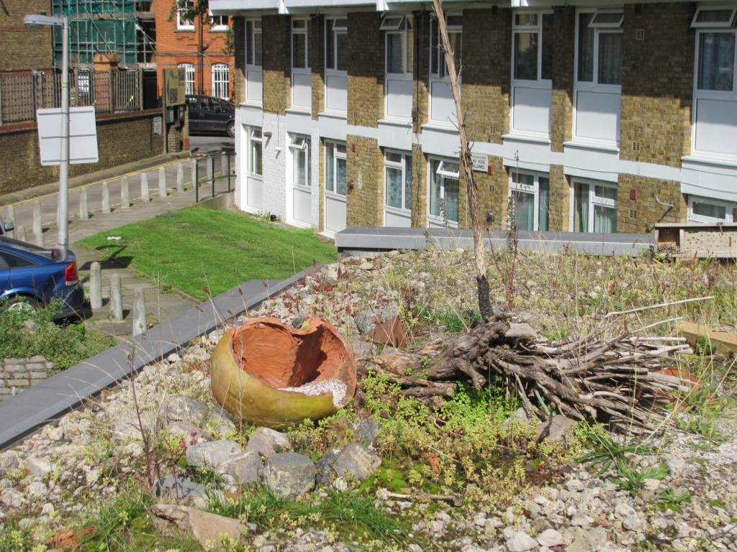
Brown
blog.emap.com
Lambeth, Central London, UK
Brown ruble substrate
Notes:
Lambeth is a district in Central London, England
Brown roof above a meeting room at Roots and Shoots. Its aim was to improve local biodiversity. The roof has a substrate of brown rubble, and very little was actually planted; most of the green that can be seen on the roof has self seeded.

Slide 15
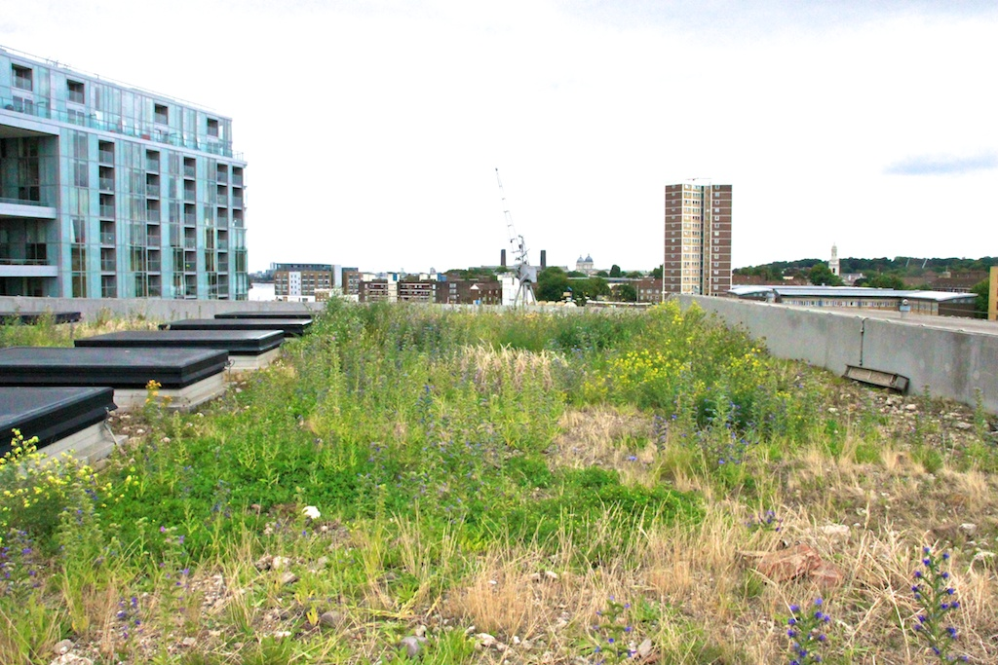
Brown
plus.google.com
Laban Dance Center, London England
Designed to encourage Black Redstart (bird)
Notes:
Wikipedia
Laban, a centre for contemporary dance in London, has a brown roof specifically designed to encourage the nationally rare black redstart. The Black Redstart (Phoenicurus ochruros) is a small passerine bird in the redstart genus Phoenicurus.

Slide 16
Semi-Intensive
At least 25 % (roof area) of substrate above (or below) 6”
100 – 250 mm substrate
Greater diversity of plants, compared to extensive
Still focused on
low maintenance plants
Lower weight
Green Roof Centre (2007) The Green Roof Pocket Guide, 2nd Ed.
Notes:
http://www.3riverswetweather.org/
Semi-Intensive: Semi-intensive green roofs can be defined as a hybrid between intensive and extensive green roofs, where at least 25 percent of the roof square footage is above or below the six inch threshold. Semi-intensive and intensive green roofs are designed to be used by the public or building tenants as a park or relaxation area. However, they also require greater capital and maintenance investments than extensive green roofs.

Slide 17
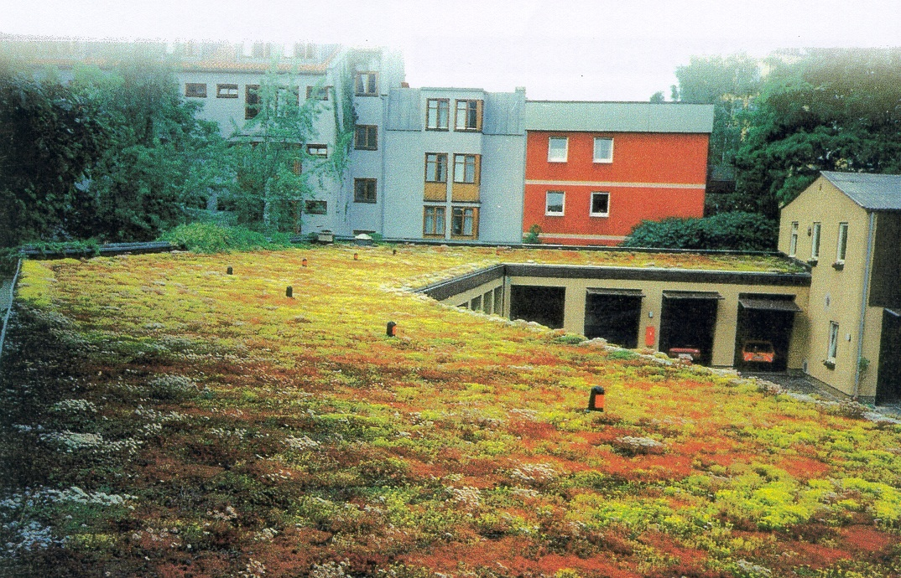
Semi-Intensive
Germany
greeningthecity.files.wordpress.com

Slide 18
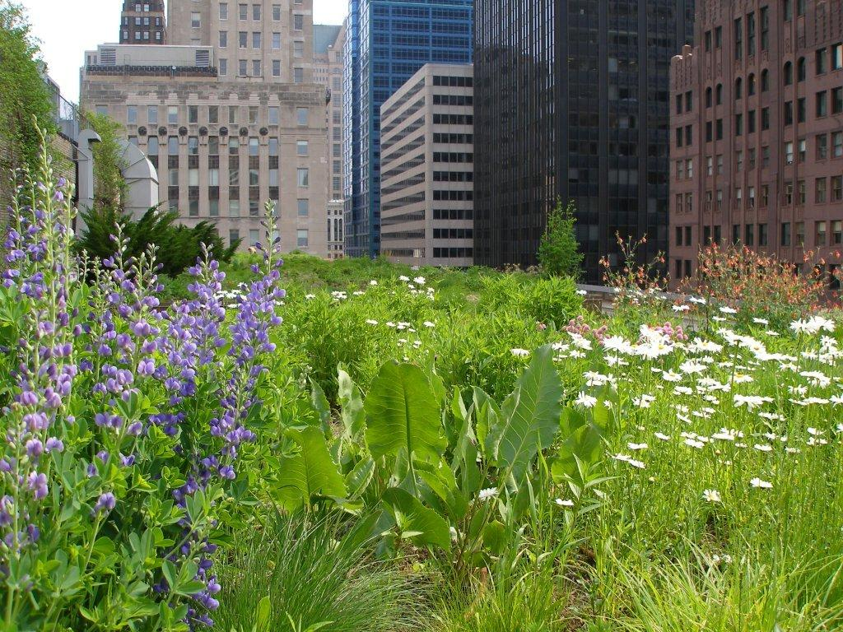
Semi-Intensive
Chicago City Hall (2001)
www.greenroofs.com
Notes:
Project Name: Chicago City Hall Year: 2001 Owner: City of Chicago, Dept of Environment Location: Chicago, IL, USA Building Type: Municipal/Government Type: Semi-Extensive, Test/Research System: Single Source Provider Size: 20300 sq.ft. Slope: 1.5% Access: Accessible, Private Submitted by: Linda S. Velazquez Designers/Manufacturers of Record: Greenroof System: Roofscapes, Inc. (now Roofmeadow) Roofscapes Contractor: Church Landscape Landscape Architect: Conservation Design Forum Architect: McDonough + Partners Project Engineer: Roy F. Weston, Inc. General Contractor: Bennett and Brosseau Roofing Waterproofing: Sarnafil Greenroof Consultant: J?rg Breuning, Green Roof Service LLC

Slide 19
Green Roof Benefits
Increase life of roof membranes
Reduce UV & Mechanical damage
2 – 3 times greater life span
Roof can last building life time
Energy savings
Can reduce air conditioning needs by up to 75 %
Better Insulated
Evapotranspiration cooling
Green Roof Centre (2007) The Green Roof Pocket Guide, 2nd Ed.

Slide 20
Benefits
Reduce storm water
Less costly than traditional systems
Reduce urban heat island effect
Meet green building standards
Meet planning requirements
Some construction wastes can be incorporated into substrate
Increase property value
Green Roof Centre (2007) The Green Roof Pocket Guide, 2nd Ed.

Slide 21
Cost Factors
Type of green roof
Extra support structure (Intensive)
Engineering fees
Pitch, edging and roof details
guttering, skylights,…
Roof Size
economy of scale
Time of year and type of planting
Building height - Crane
Maintenance, irrigation and access
Green Roof Centre (2007) The Green Roof Pocket Guide, 2nd Ed.

Slide 22
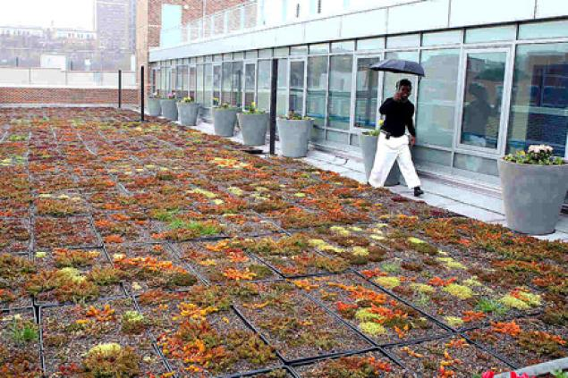
Cost
As much as 2x cost of waterproofing & insulating standard roof
assets.nydailynews.com
Green Roof Centre (2007) The Green Roof Pocket Guide, 2nd Ed.

Slide 23
Maintenance
Annual removal of unwanted weeds & saplings
Annual clearing of drainage outlets
Same as traditional roofs
Irrigation in case of drought
Best to pay installer maintain for ~2 years, until plants established
Green Roof Centre (2007) The Green Roof Pocket Guide, 2nd Ed.

Slide 24
Structural Support
Extensive green roofs fall within load of standard roofs
Type | Load per area (kg/m²)
Gravel Surface | 90 - 150
Paving Slabs | 160 - 220
Extensive green roof | 60 - 150
Intensive green roof | 200 - 500
Green Roof Centre (2007) The Green Roof Pocket Guide, 2nd Ed.

Slide 25
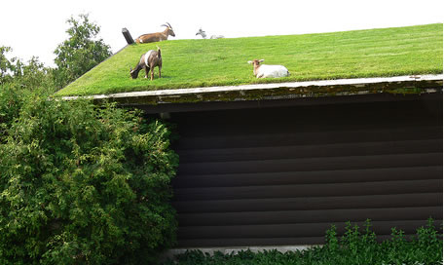
Pitch
Any pitch is possible
Above 9.5° care must be take to keep substrate in place and retain water
Cross battens can be used up to 35°
Closer together as pitch increases
node1.ecogeek-cdn.net
Green Roof Centre (2007) The Green Roof Pocket Guide, 2nd Ed.

Slide 26
Components
Vegetation
Substrate
Drainage / Aeration / Water Storage / Root Barrier
Insulation
Membrane Protection & Root Barrier
Roofing Membrane
Structural Support
www.greenroofplan.com
www.greenroofplan.com
Green Roof Centre (2007) The Green Roof Pocket Guide, 2nd Ed.

Slide 27
Planting Options
Pre-grown Mats
Cover established fast, highest cost, low diversity
Plugs
Lower cost, cover takes a bit longer, some plants may not be available
Seeds or cuttings
Low cost, 1-3 years to establish, sow in fall/spring
Natural Colonization
Lowest cost, high biodiversity, aesthetics may suffer, longest time to establish
Green Roof Centre (2007) The Green Roof Pocket Guide, 2nd Ed.

Slide 28
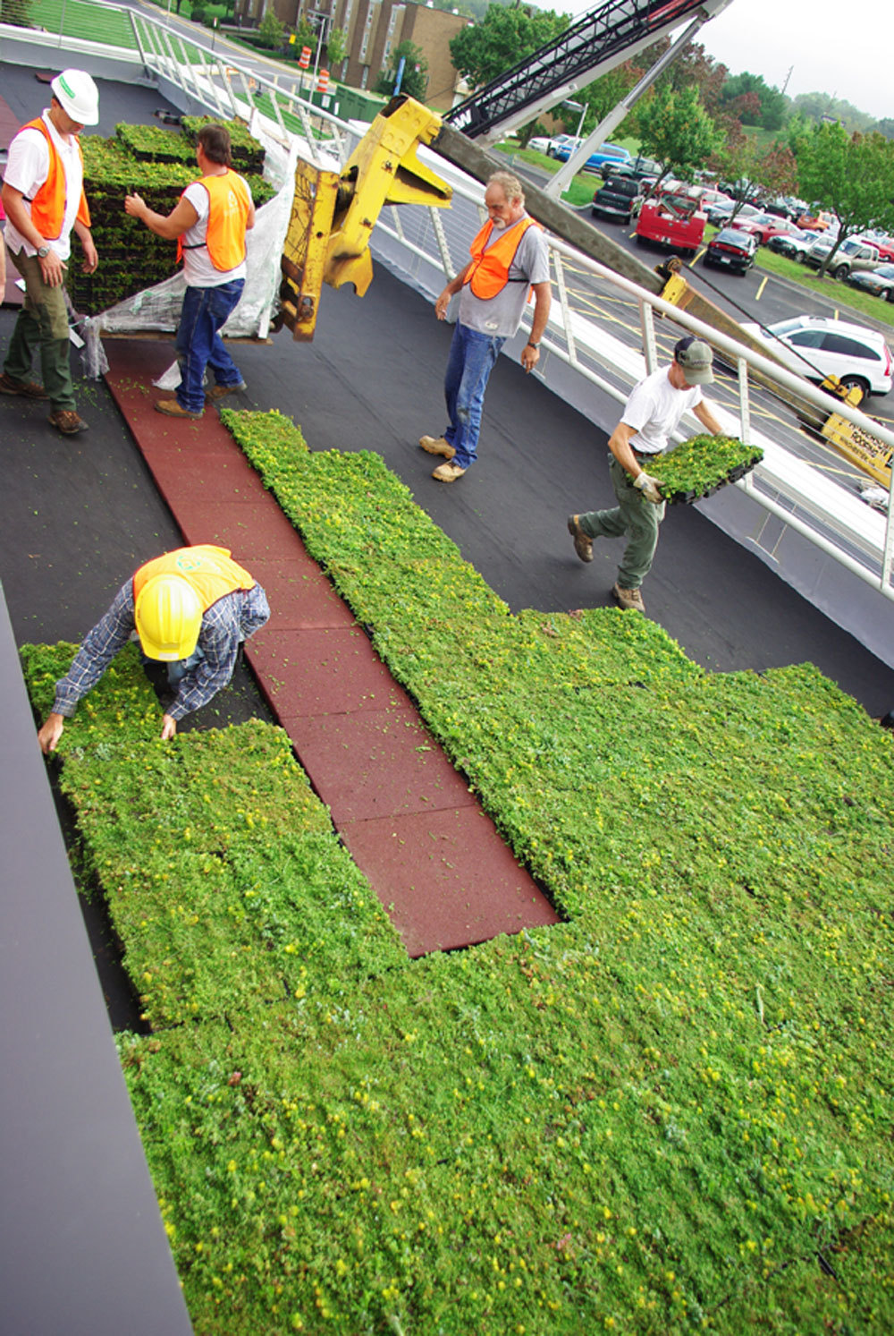
Installation
Modular
Trays
Layers
Trays
www.vegetalid.us

Slide 29
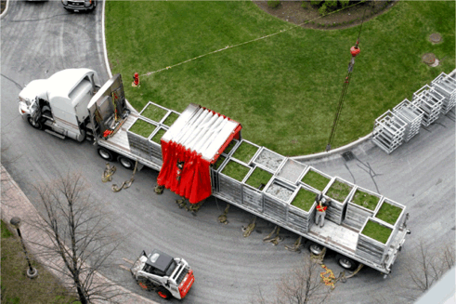
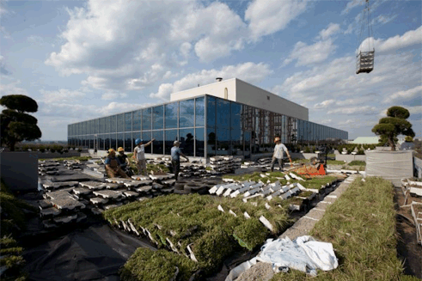
ESRI Canada - Garden in the Sky
Trays!
www.greenroofs.com
Notes:
Project Name: ESRI Canada's Garden in the Sky Year: 2009 Owner: ESRI Canada Location: Toronto, Canada Building Type: Corporate Type: Extensive & Intensive System: Single Source Provider Size: 7500 sq.ft. Slope: 1% Access: Accessible, Private Submitted by: Josephine Chan, ESRI Canada Designers/Manufacturers of Record: Landscape Architect: Scott Torrance Landscape Architect Inc. Landscape Contractor/Installation: Gardens in the Sky Modular Greenroof System: LiveRoof Hybrid

Slide 30
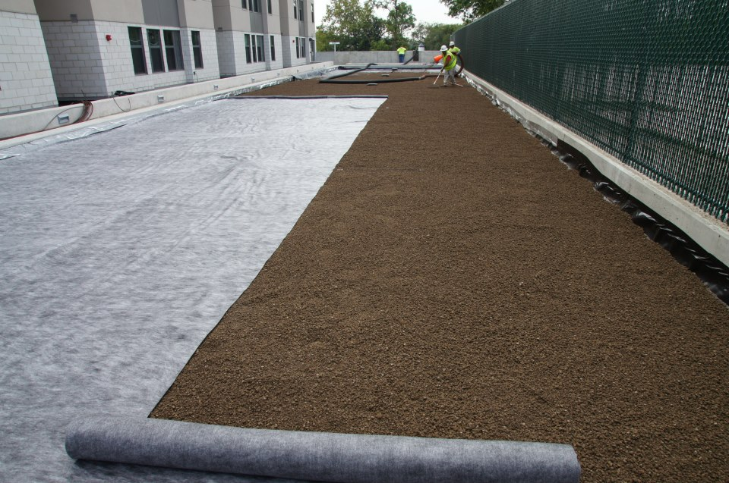
Layers
www.hvcnyc.com

Slide 31
Lincoln Center, NYC
geosyntheticsmagazine.com

Slide 32
Lincoln Center, NYC
Geocells
geosyntheticsmagazine.com

Slide 33
Lincoln Center, NYC
geosyntheticsmagazine.com

